Slide 1


Data Management Project
Data Warehouse: Build of a three layer architecture through ETL process, DFM schema and star schema.
Cured by Jacopo Maria Barile 2208592

Slide 2
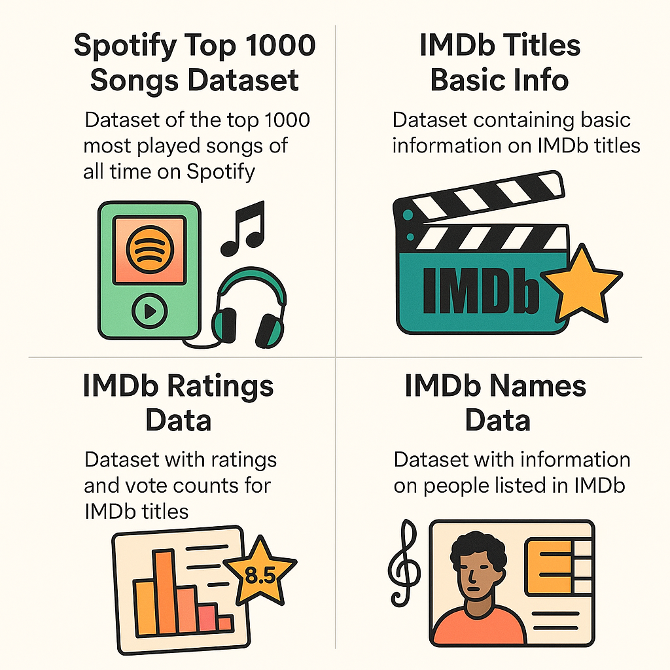
Phase 1.0: Source Layer
Selection of external and operational data.
Data Management Project
Pagina <number>

Slide 3




Phase 2.0: Data Staging
ETL Tools to process the external data sources.
2.1: Extraction and Cleansing
2.2: DFM and Star Schema
2.3: Transformation
2.4: Loading
Data Management Project
Pagina <number>

Slide 4
Phase 2.1: Extraction and Cleansing
Process to improve data quality and pre-Transformation.
Static Extraction performed.
Cleansing of data inconsistencies:
  Dropping duplicates.
  Dropping rows with missing data.
  Dropping useless Titles and Names data.
  Dropping inconsistent Tracks data.
Join of cleansed datasets.
Fuzzy Matching of Tracks and Titles data.
Data Management Project
Pagina <number>

Slide 5
Phase 2.2: DFM and Star Schema
Dimensional Fact Model.
3 Dimensions developed:
  Artist.
  Track.
  Title.
Shared Hierarchy developed on the Artist Dimension.
Optional and Multiple Arcs developed.
Different Levels and Additivity of Measures developed.
Data Management Project
Pagina <number>

Slide 6
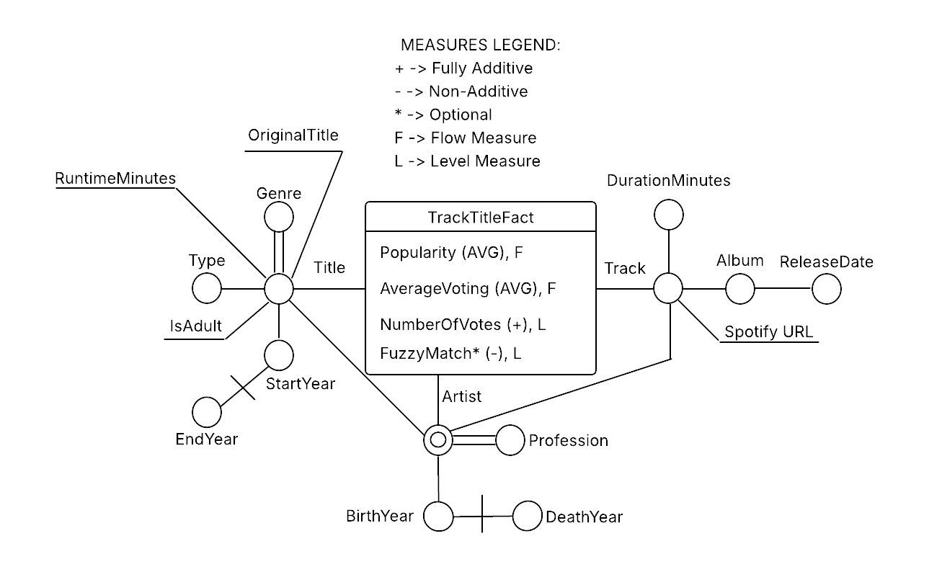
Phase 2.2: DFM and Star Schema
Dimensional Fact Model
Data Management Project
Pagina <number>

Slide 7
Phase 2.2: DFM and Star Schema
Star Schema.
7 Dimension Tables developed.
Bridge Tables developed:
  Bridge_Genre.
  Bridge_Profession.
Foreign Keys and Integrity Constraints developed.
Optional Measures and Attributes developed.
Data Management Project
Pagina <number>

Slide 8
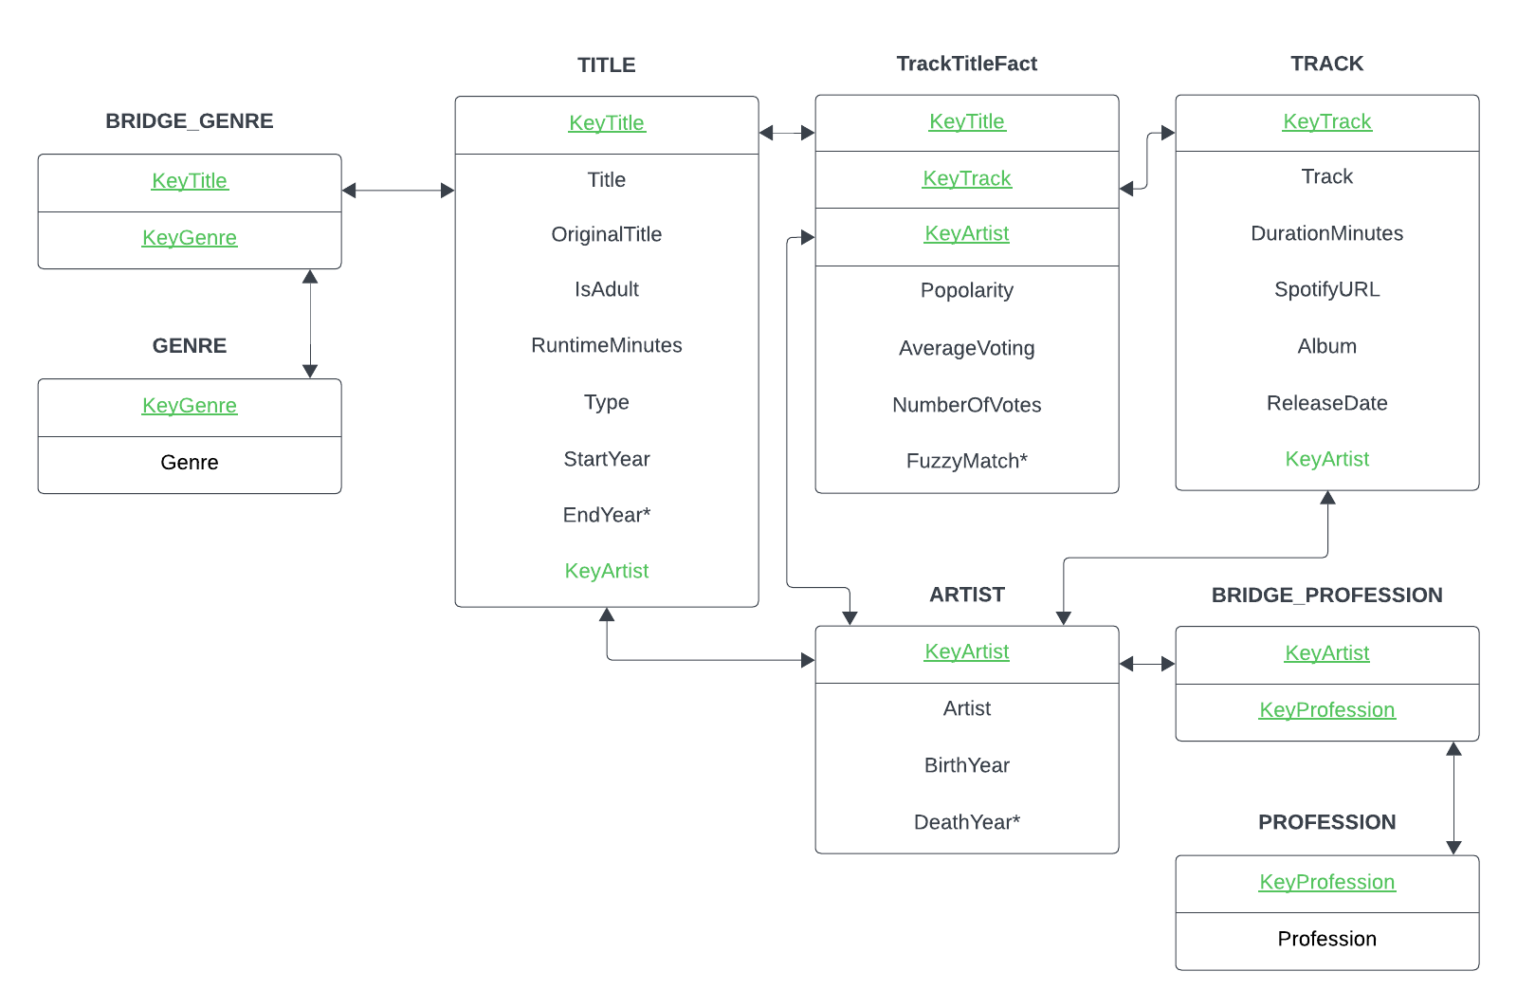
Phase 2.2: DFM and Star Schema
Dimensional Fact Model
Data Management Project
Pagina <number>

Slide 9
Phase 2.3: Transformation
ETL Tools to process the external data sources.
Data Management Project
Pagina <number>

Slide 10
Phase 2.4: Loading
ETL Tools to process the external data sources.
Data Management Project
Pagina <number>

Slide 11
Selezionare per scrivere o eliminare il sottotitolo
Titolo Presentazione
Pagina <number>

Slide 12
Selezionare per scrivere o eliminare il sottotitolo
Titolo Presentazione
Pagina <number>

Slide 13
Selezionare per scrivere o eliminare il sottotitolo
Data Management Project
Pagina <number>

